Slide 1


Chicago Divvy Bike Sharing Data .
Authors: Smit Shiroya Linray Song Kathryn Joy Mak Pratik Parmar
Under the Guidance Of: Dr. Jongwook Woo
Notes:
https://www.chicago.gov/city/en/depts/cdot/provdrs/bike/news/2017/december/divvy-announces-new-fare-options-and-benefits--including--3-sing.html
https://s3.amazonaws.com/divvy-data/index.html

Slide 2
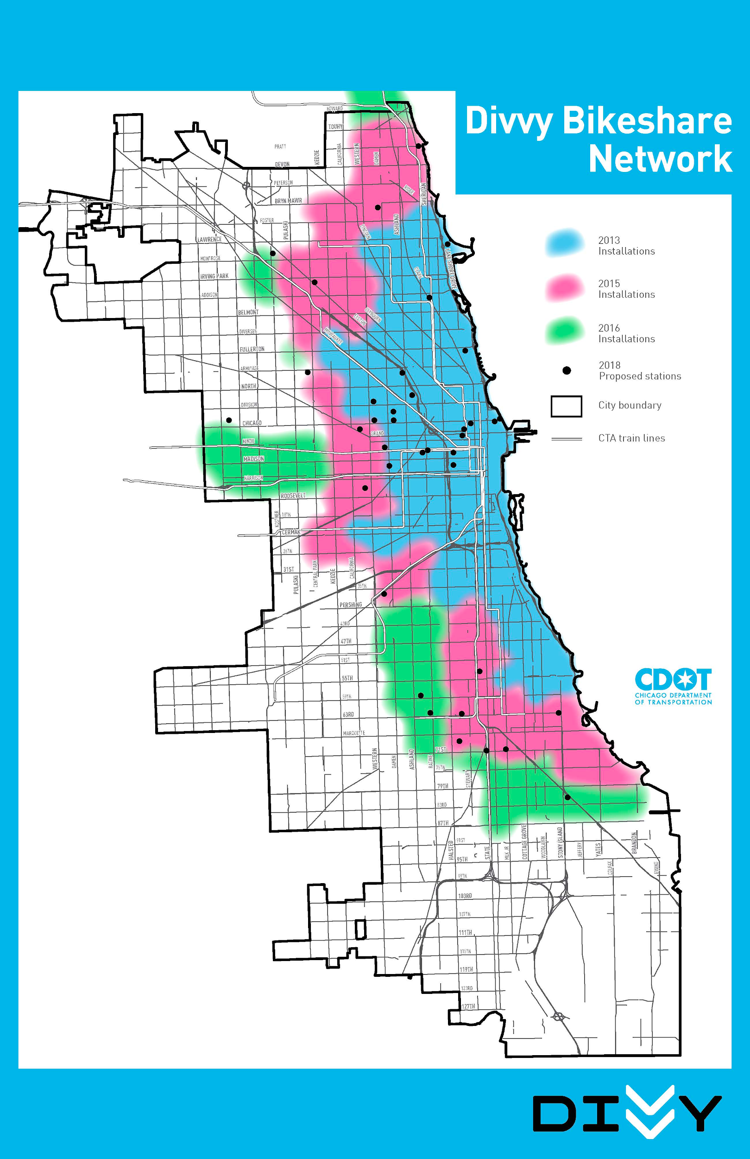
INTRODUCTION
Divvy is Chicago’s bike share system, with 6,000 bikes available at 570+ stations across Chicago and Evanston.
Divvy, like other bike share systems,
consists of a fleet of specially designed, sturdy and durable bikes that are locked into a network of docking stations throughout the region.
Notes:
Why ? Divvy is Chicago’s top bike share program. Good and rich dataset to ensure accuracy & reliability of the data What's Better to explore the beautiful lakeshores of Chicago thru Divvy bike share system. Chicago like many other major cities w/ 26mi of lakefront & 19 mi lakefront bicylcles pass.

Slide 3






HOW IT WORKS: BIKE SHARE
Unlock the bike through Divvy’s app to pick up/drop off from any station in the system to commute to work or school, or explore Chicago and more.
Notes:
Fun & affordable way to get around to town
The bikes can be unlocked from one station and returned to any other station in the system. People use bike share to explore Chicago, commute to work or school, run errands, get to appointments or social engagements, and more.

Slide 4

OBJECTIVES .
In this lab, you will analyze and visualize Chicago Divvy Bike Sharing Data. Thus, you will...
Learn how to download data to the local systems in AWS.
Learn how to upload it to HDFS.

Slide 5

OBJECTIVES
https://github.com/smitshiroya/5200
You will figure out how to manipulate and analyze the data in HDFS using HiveQL.
You will also practice how to visualize the result in Excel and Power BI.
Notes:
https://github.com/smitshiroya/5200
https://youtu.be/ql0y_4GPRes

Slide 6
ABOUT THE DATASET
Dataset | http://bit.ly/ChicagoDivvy
Data Reviewed: | 2013 to 2017
File Size: | 5.00 GB
Number of Files: | 1
File Format: | CSV (Comma Separated Values)
Total no. of entries: | 9.57 million

Slide 7

PLATFORM SPECIFICATION
Cluster Version – Amazon Web Service
Number of Nodes – 3
Memory size – 150 GB
CPU – 20 vCPU
CPU speed – 2.5 GHz
HDFS capacity – 147 GB
Storage – 678 GB
Notes:
Platform specification

Slide 8
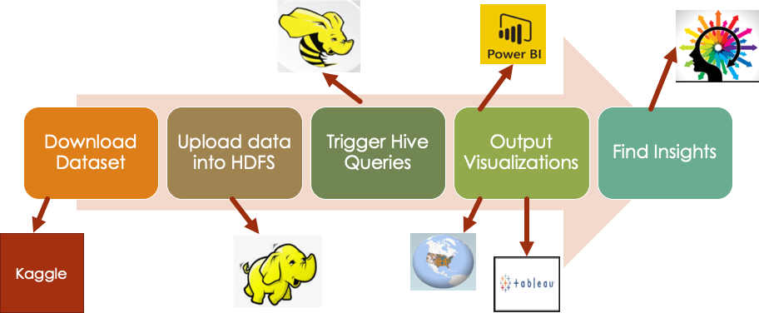
FLOWCHART

Slide 9
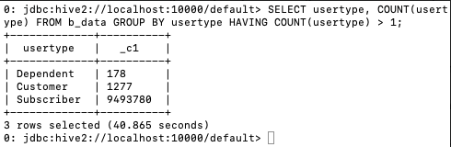
Step: Get data manually by using Hadoop-Hives
SQL Query :
SELECT usertype, COUNT(usertype) FROM b_data GROUP BY usertype HAVING COUNT(usertype) > 1;

Slide 10
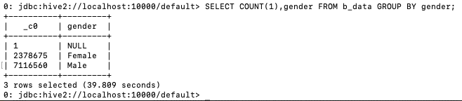
Step: Get data manually by using Hadoop-Hives
SQL Query :
SELECT COUNT(1),gender FROM b_data GROUP BY gender;

Slide 11
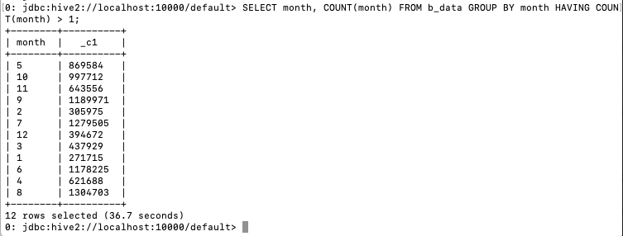
Step: Get data manually by using Hadoop-Hives
SQL Query:
SELECT month, COUNT(month) FROM b_data GROUP BY month HAVING COUNT(month) > 1;

Slide 12
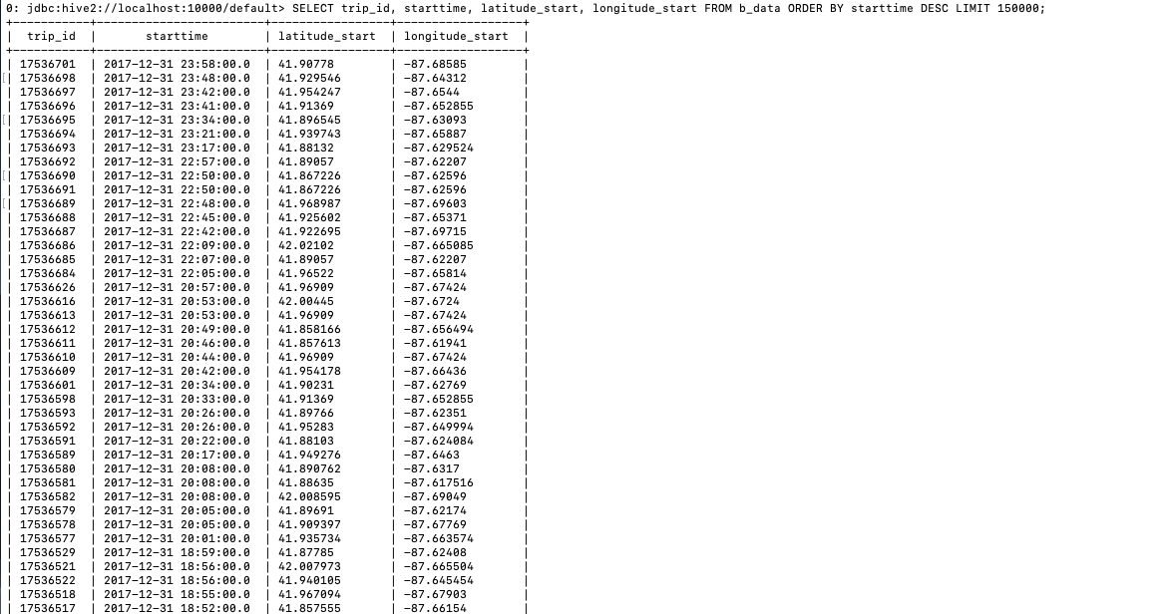
Step: Get data manually by using Hadoop-Hives
SQL Query:
SELECT trip_id, starttime, latitude_start, longitude_start FROM b_data ORDER BY starttime DESC LIMIT 150000;

Slide 13
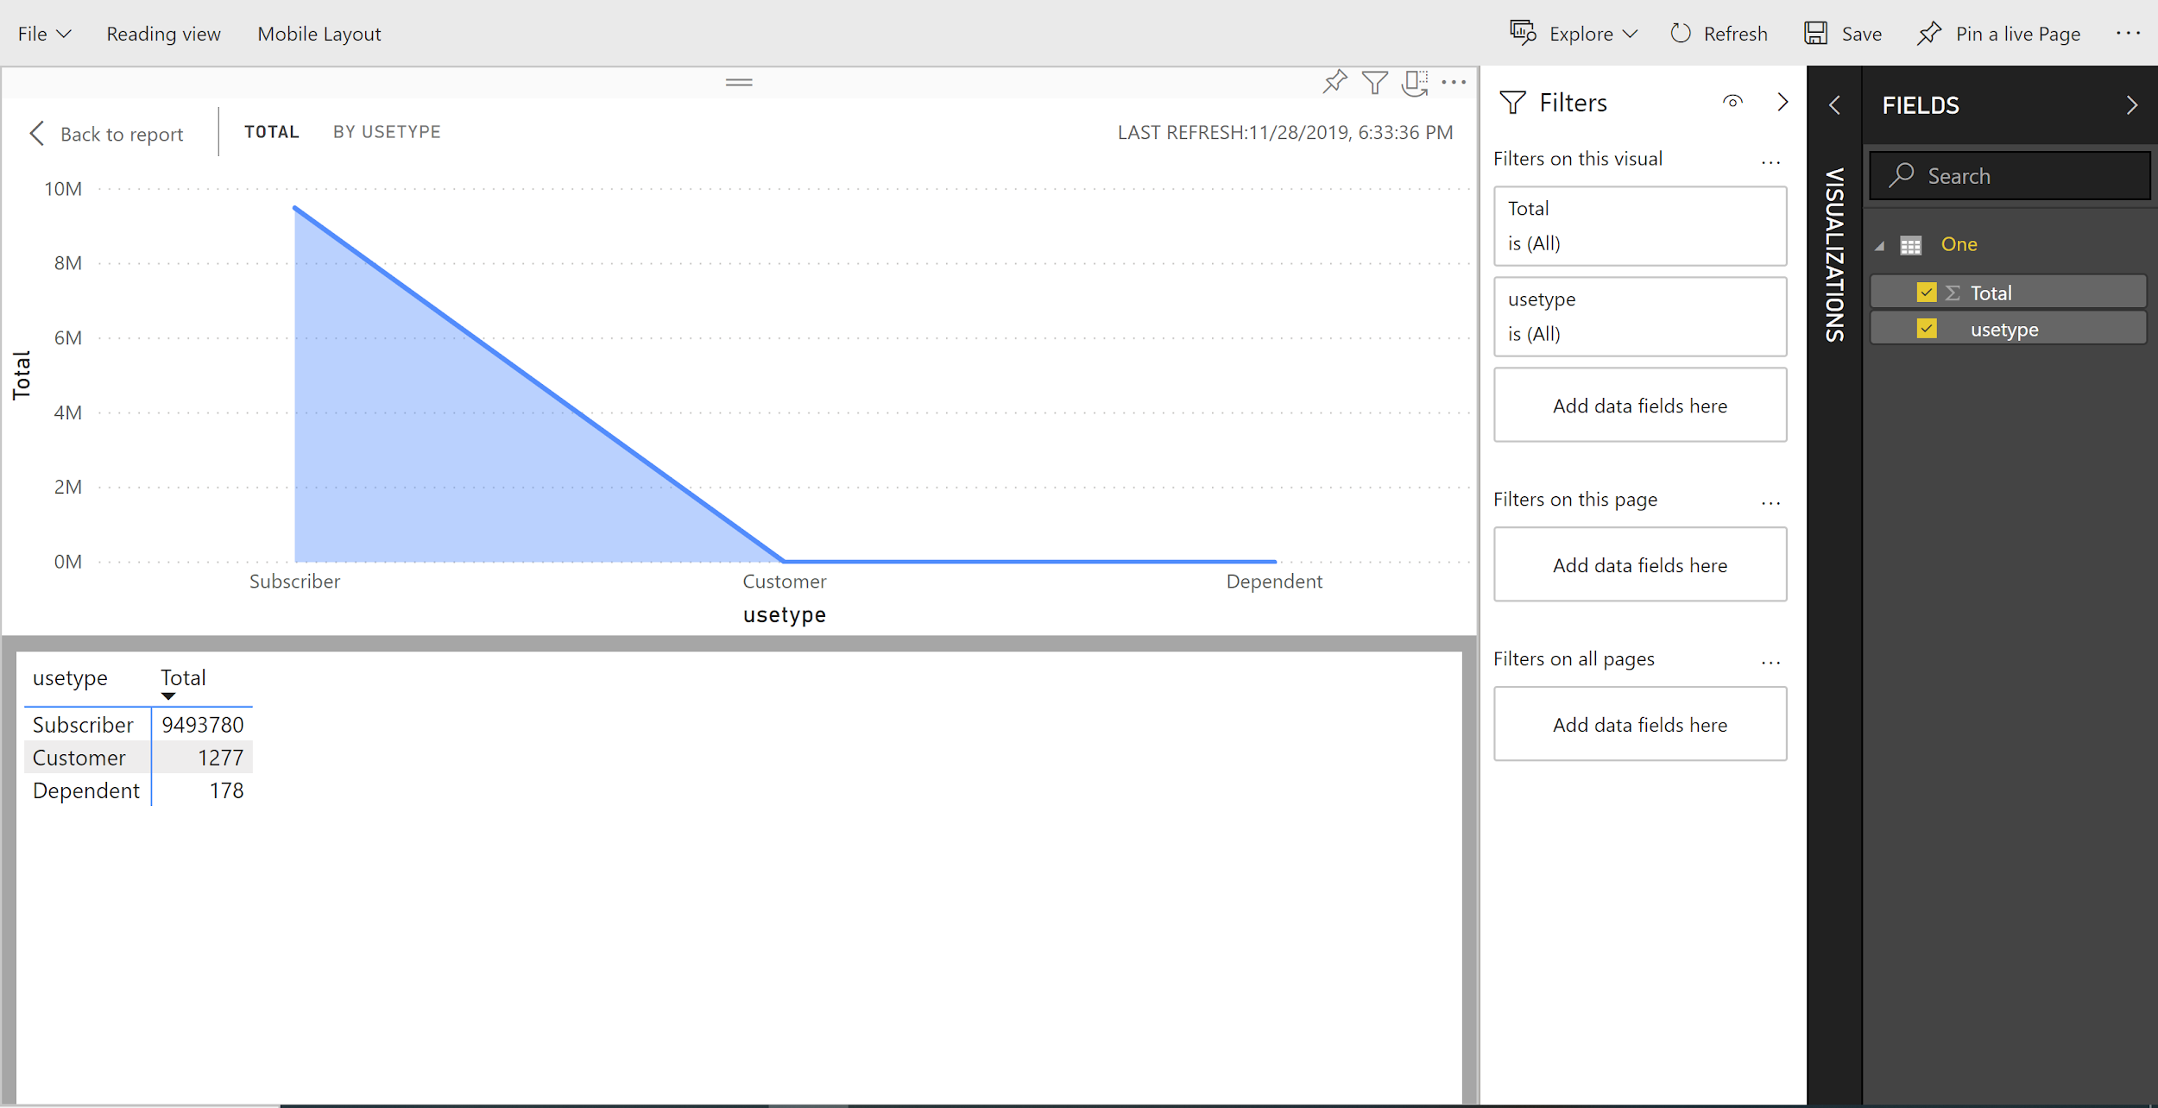
Step: Visualization by using Power BI

Slide 14
Step: Visualization by using Power BI
In order to achieve the completed visualization, we uploaded the dataset from excel and imported into Power BI.
This visualization indicates the different types of users with Divvy.

Slide 15
Step: Visualization by using Power BI
Divvy focuses on local area users, such as local business offices, local college students, and local subscribers.
Local Subscribers, travelers and visitors, are the most bicycle using in daily.

Slide 16
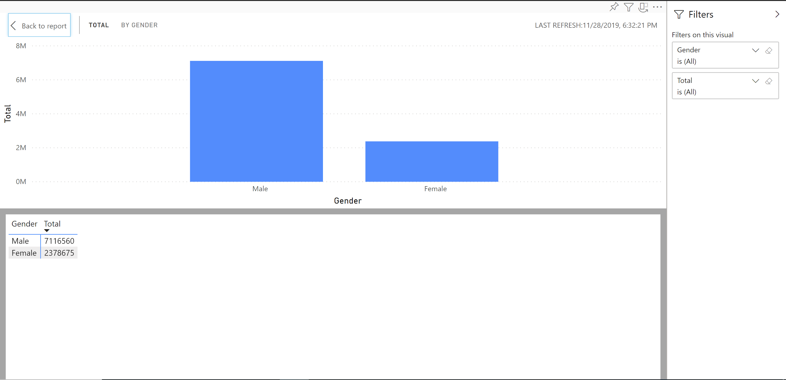
Step: Visualization using Power BI

Slide 17
Step: Visualization using Power BI
This visualization indicates which gender is more likely to use the Divvy bike rental services.
From the analysis, we found out Male users are more than Female users in using bicycles for daily transportation.
Therefore, for future business products developing, Divvy should target male users.

Slide 18
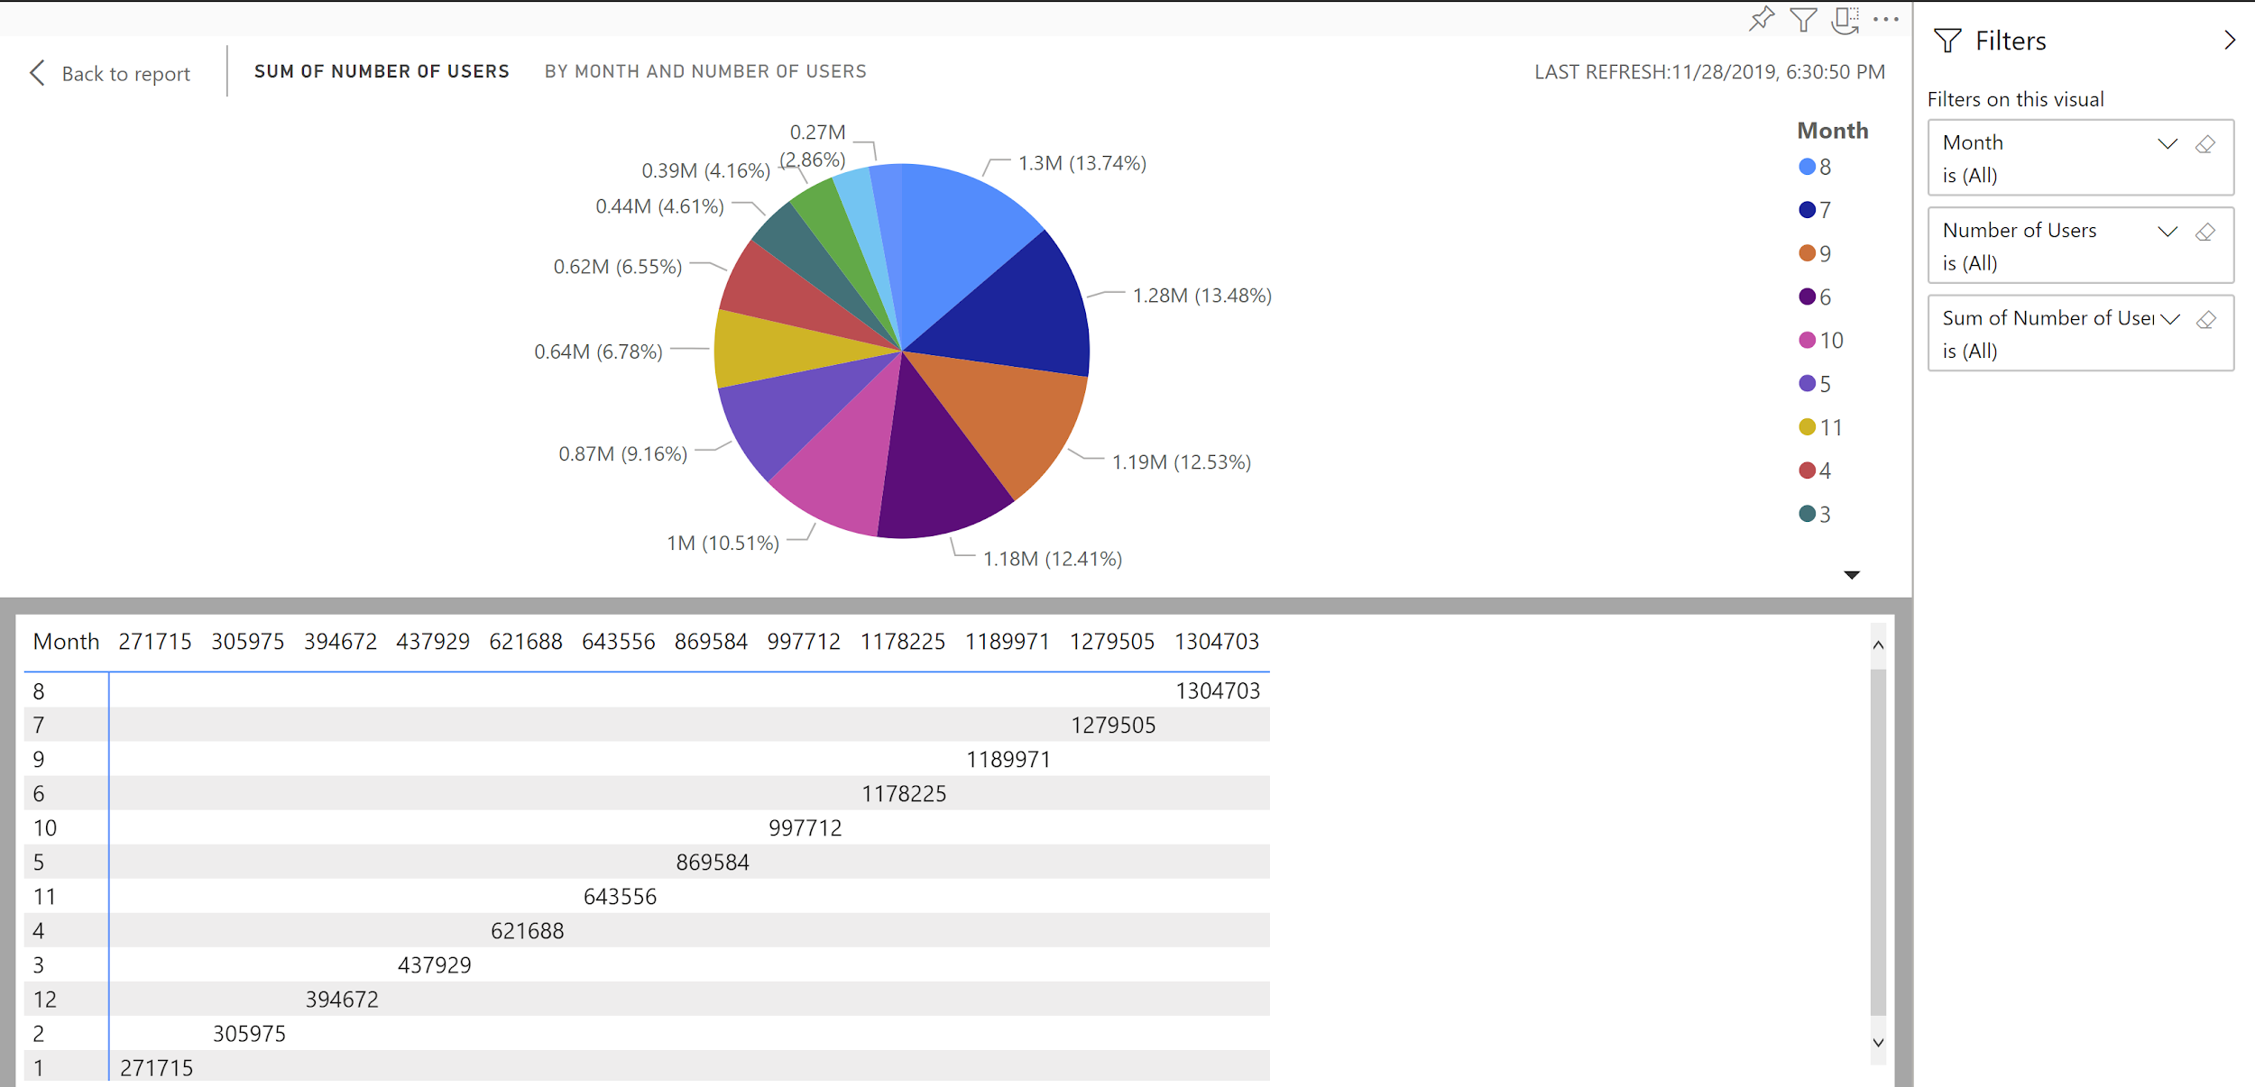
Step: Visualization using Power BI

Slide 19
Step: Visualization using Power BI
In business analysis, we try to figure out what key elements that affect Divvy’s business.
According to the pie chart, weather is the major component affect the bicycle rental business.
Chicago has the best warm weather during summer time; therefore, this visualization shows from June till September, Divvy has the most businesses in bike rental.

Slide 20
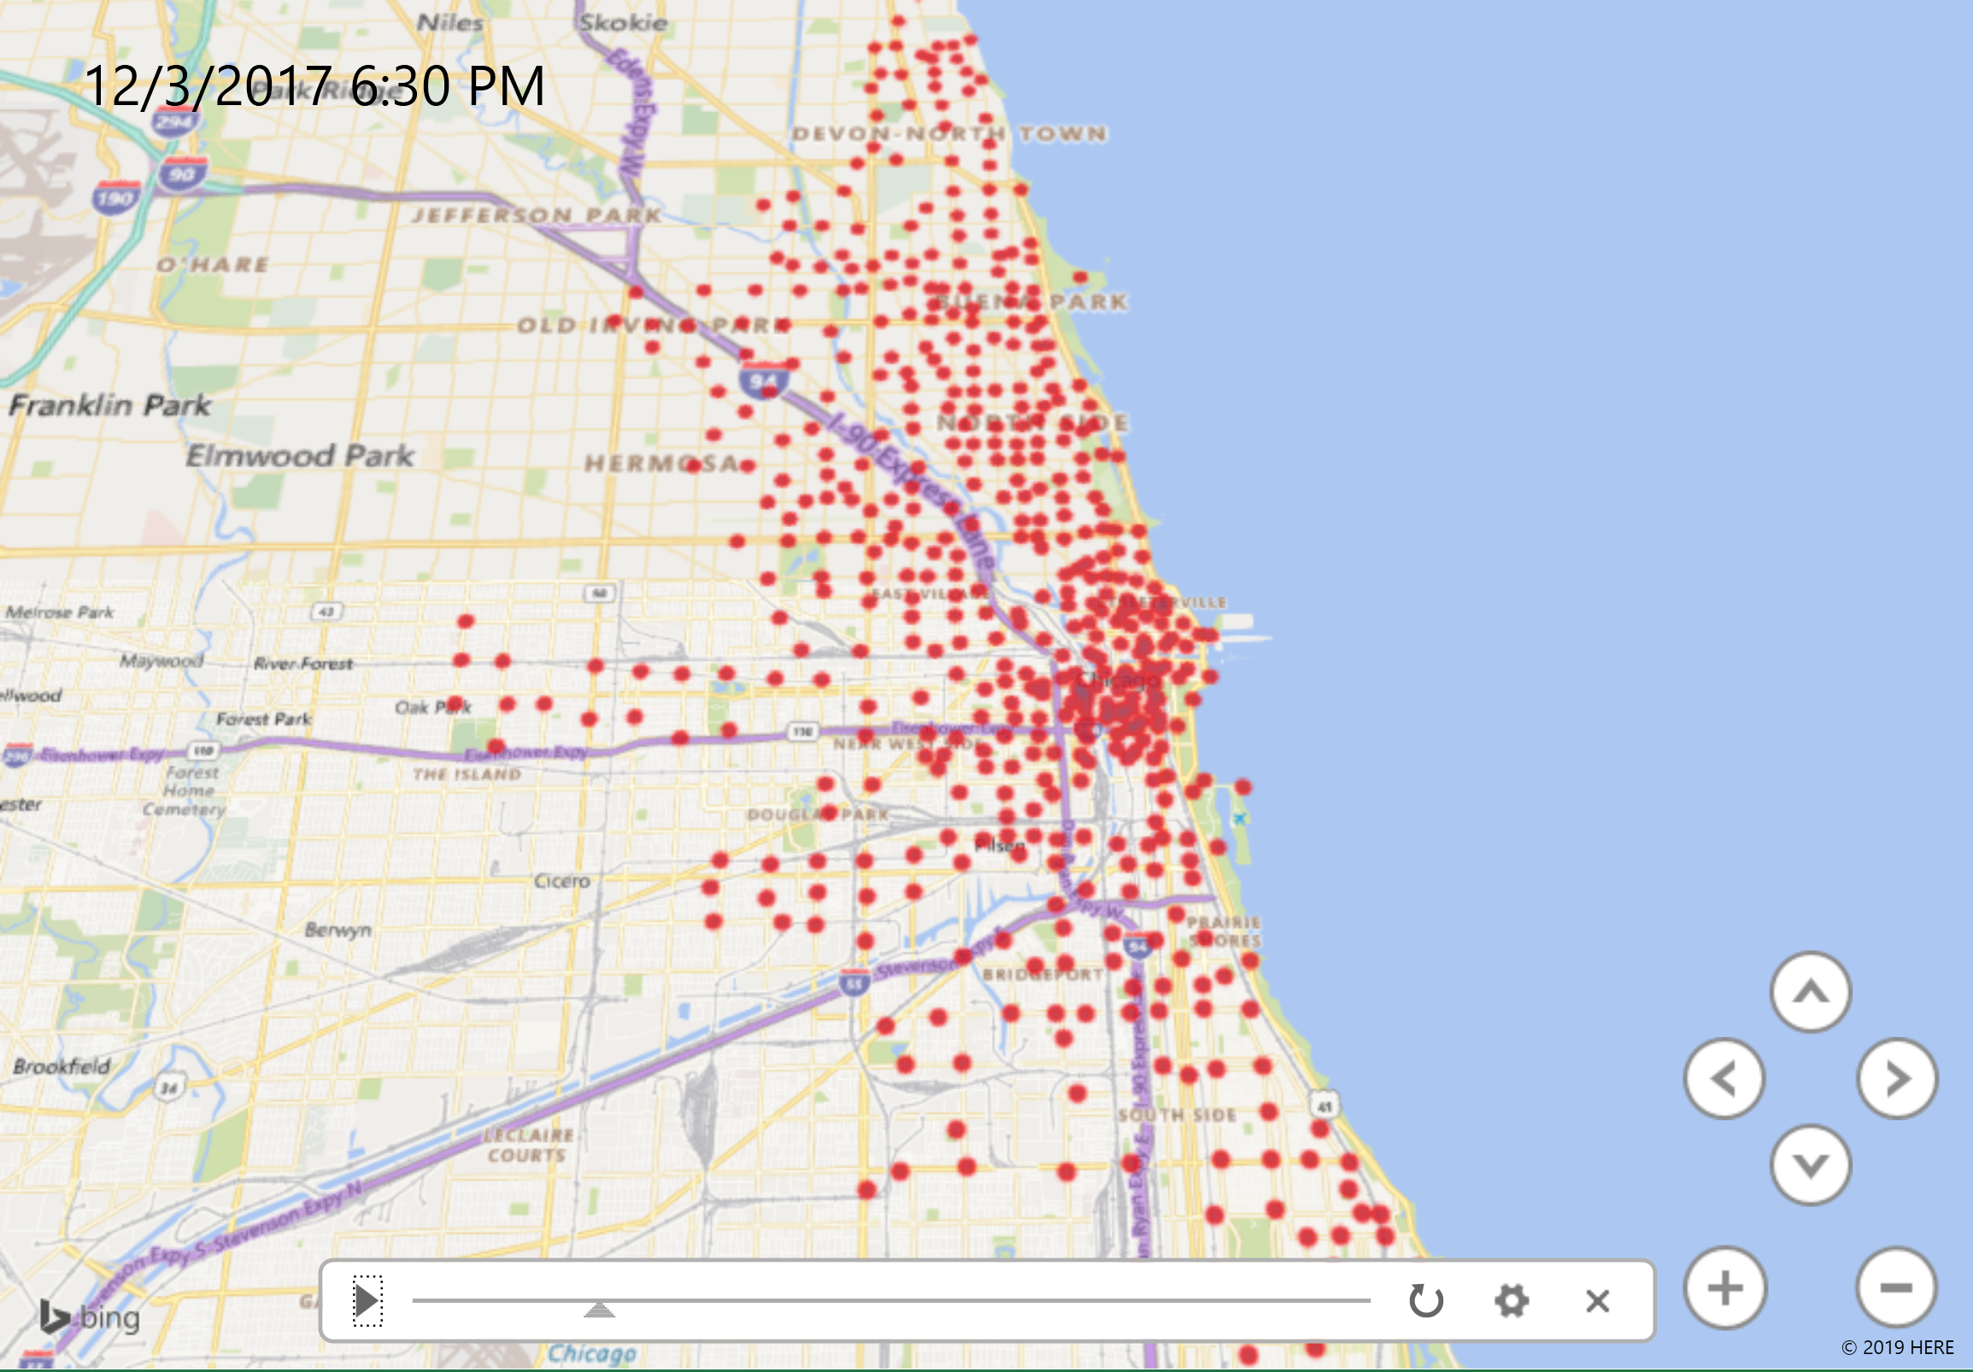
Step: Visualization using Power BI

Slide 21
Step: Visualization using Power BI
The last visualization indicates the regions that covered by Divvy’s bike rental business.
Most of Divvy’s bike rental regions are nearby the beach.
It reflects the local subscribers, who are the travelers and visitors, are more frequently using the Divvy’s bike rental.

Slide 22
Conclusion
According to this project, we demonstrate how data analysis in using for business decisions making, such as find out the target clients, the importance of key elements and location for marketing. Also,
download dataset and upload to HDFS in Amazon Cloud.
manipulate and analyze the data in HDFS using HiveQL.
visualize the result in Excel and Power BI.

Slide 23
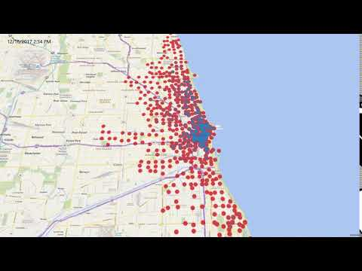
Subscribe our Youtube Channel

Slide 24
References
URL of Data Source, https://www.kaggle.com/yingwurenjian/chicago-divvy-bicycle-sharing-data#data.csv
Motivate International, Inc. “About Divvy: Company & History.” Divvy Bikes, 2019, www.divvybikes.com/about.

